Slide 1
Lecture 7a
The Link Layer

Slide 2
Simplified Web Browsing
There is a structured “flow”
between layers at each end
Message from Alice’s Browser
Web server process gets message
TCP Segments Created
TCP segment is recovered, assembled
IP datagrams carry TCP segments
Looks at IP DA for routing
Edge router receives IP datagram
IP datagram is picked up from frame
Ethernet in Alice’s PC creates frame
Ethernet in router gets frame , checked for errors
Transport
Puts it in Ethernet frame
Ethernet in server gets frame, checks for errors
Ethernet cable carries signal to edge router
Cable carries the signal representing Ethernet frame to server machine
There is a one-to-one correspondence
between layers in the two end points

Slide 3
















Simplified Internet Structure
Transport
mobile network
Hierarchical
Access network has a router that connects it to a regional ISP
Regional ISPs connect to global ISPs
Remember: Router = packet switch
global ISP
home
network
regional ISP
institutional
network
Figure from Kurose-Ross
Notes:
Most enterprise computer networks can be separated into two general types of technology: local area networks (LAN) and wide-area networks (WAN). LANs typically connect nearby devices: devices in the same room, in the same building, or in a campus of buildings. In contrast, WANs connect devices that are typically relatively far apart. Together, LANs and WANs create a complete enterprise computer network, working together to do the job of a computer network: delivering data from one device to another.
Many types of LANs have existed over the years, but today’s networks use two general types of LANs: Ethernet LANs and wireless LANs. Ethernet LANs happen to use cables for the links between nodes, and because many types of cables use copper wires, Ethernet LANs are often called wired LANs. In comparison, wireless LANs do not use wires or cables, instead using radio waves for the links between nodes.

Slide 4
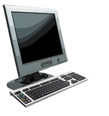
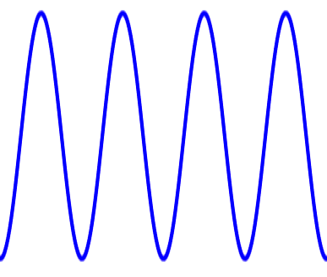
Encapsulation
Slide modified from Kurose-Ross
source
message
M
application
transport
network
link
physical
segment
H_{t}
M
H_{t}
datagram
H_{n}
H_{n}
H_{t}
M
frame
H_{l}
H_{n}
H_{t}
M
Alice
Signal
link
physical
Uses “link or MAC address” at frame level
switch
Bob
destination
H_{n}
H_{t}
M
network
link
physical
M
application
transport
network
link
physical
H_{l}
H_{n}
H_{t}
M
H_{n}
H_{t}
M
H_{t}
M
H_{n}
H_{t}
M
H_{l}
H_{n}
H_{t}
M
Uses “IP address” at datagram/network level
router

Slide 5
Remarks
Observe carefully
How much of the physical layer bits are “moved” up the stack at various nodes
What does a “layer-2” switch do?
What does a router do?
Does it look at the IP datagram? At the TCP segment? At the application payload?
When is a TCP segment reassembled?
This is end-to-end

Slide 6
Link Layer
“link”
Hosts and routers are nodes
Communication channels that connect adjacent nodes along communication path are links
wired links, wireless links
Layer-2 packet is a frame, encapsulates IP datagram
Note, datagram maybe transferred by different link layer protocols over different links
data-link layer has responsibility of transferring data from one node
to adjacent node over a link

Slide 7
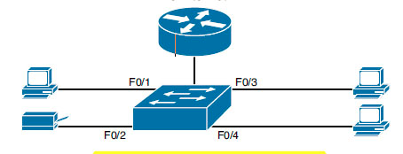
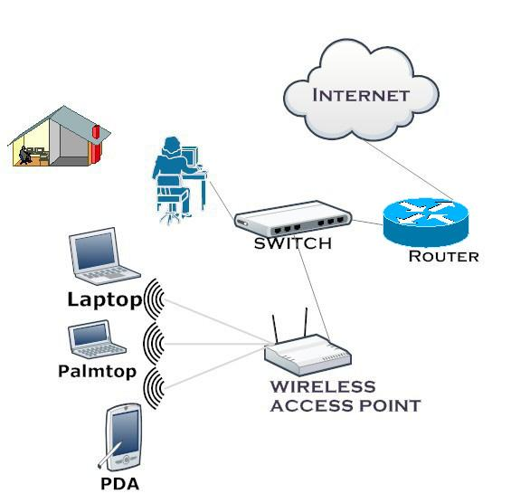
Typical SOHO LANs
Notes:
Figure shows a drawing of a SOHO Ethernet LAN. The figure shows a single LAN switch, five cables, and five other Ethernet nodes: three PCs, a printer, and one network device called a router. The router connects the LAN to the WAN, in this case to the Internet.
Although figure shows a simple Ethernet LAN, many SOHO Ethernet LANs today combine the router and switch into a single device. Vendors sell consumer-grade integrated networking devices that work as a router and Ethernet switch, as well as doing other functions. These devices typically have “router” on the packaging, but many models also have four-port or eight-port Ethernet LAN switch ports built in to the device.
Typical SOHO LANs today also support wireless LAN connections. Ethernet defines wired LAN technology only; in other words, Ethernet LANs use cables. However, you can build one LAN that uses both Ethernet LAN technology as well as wireless LAN technology, which is also defined by IEEE. Wireless LANs, defined by the IEEE using standards that begin with 802.11, use radio waves to send the bits from one node to the next.
Most wireless LANs rely on yet another networking device: a wireless LAN access point (AP). The AP acts somewhat like an Ethernet switch, in that all the wireless LAN nodes communicate with the Ethernet switch by sending and receiving data with the wireless AP. Of course, as a wireless device, the AP does not need Ethernet ports for cables, other than for a single Ethernet link to connect the AP to the Ethernet LAN.

Slide 8
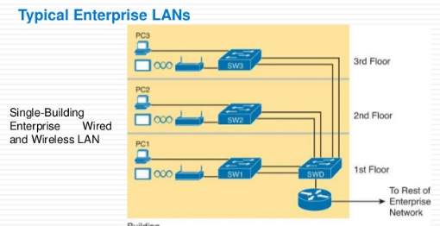
Typical Enterprise LANs
Notes:
Enterprise networks have similar needs compared to a SOHO network, but on a much larger scale. For example, enterprise Ethernet LANs begin with LAN switches installed in a wiring closet behind a locked door on each floor of a building. The electricians install the Ethernet cabling from that wiring closet to cubicles and conference rooms where devices might need to connect to the LAN. At the same time, most enterprises also support wireless LANs in the same space, to allow people to roam around and still work and to support a growing number of devices that do not have an Ethernet LAN interface.
Figure shows a conceptual view of a typical enterprise LAN in a three-story building. Each floor has an Ethernet LAN switch and a wireless LAN AP. To allow communication between follors, each per-floor switch connects to one centralized distribution switch. For example, PC3 can send data to PC2, but it would first flow through switch SW3 to the first floor to the distribution switch (SWD) and then back up through switch SW2 on the second floor.
The figure also shows the typical way to connect a LAN to a WAN using a router. LAN switches and wireless access points work to create the LAN itself. Routers connect to both the LAN and the WAN. To connect to the LAN, the router simply uses an Ethernet LAN interface and an Ethernet cable.

Slide 9
Functions of the Data-Link layer
Slide modified from Agrawal
ATIS Telecom glossary 2007
Transfer data between devices on the same network
Detect and possibly correct errors that may occur in the Physical Layer
Ethernet is the most common end-user implementation of the data-link layer
Most corporate desktops
WiFi is the most common wireless link layer
Cellular data (3G/4G) increasingly common

Slide 10
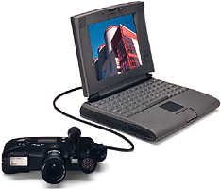
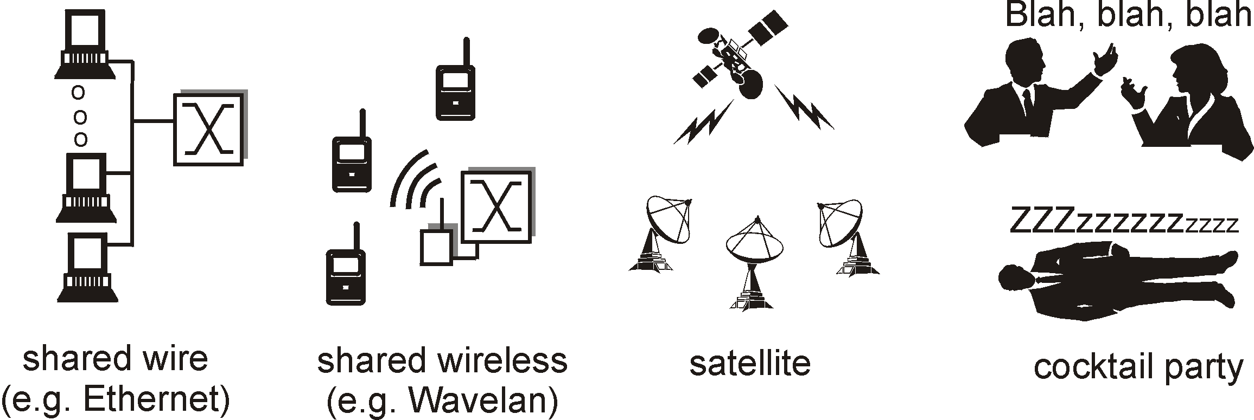
Types of links
http://www.bitmedia.com/ar96/images/pdc2000pb.jpg
Point-to-point
Bluetooth for cable replacement (shared medium)
Point-to-point link between switch and server
Broadcast (shared wire or medium) link
Ethernet, WiFi
Upstream Cable modem

Slide 11
Link Layer Services
Also at the transport layer – “end-to-end”
Framing
Encapsulate datagram into frame, adding header, trailer, addressing
Format/encode for physical layer
Channel access (if shared medium) (MAC)
Control who uses channel and routing/reception of data
Communication Mode
Simplex – one way communication (e.g., broadcast AM)
Duplex – two way communication
TDD (half Duplex) vs. Full Duplex
Flow Control:
Pacing between adjacent sending and receiving nodes
Reliable delivery between adjacent nodes
Error Detection
receiver detects presence of errors: asks sender for retransmission or drops frame (ARQ)
Error Correction
receiver identifies and corrects bit error(s) without resorting to retransmission (FEC)

Slide 12
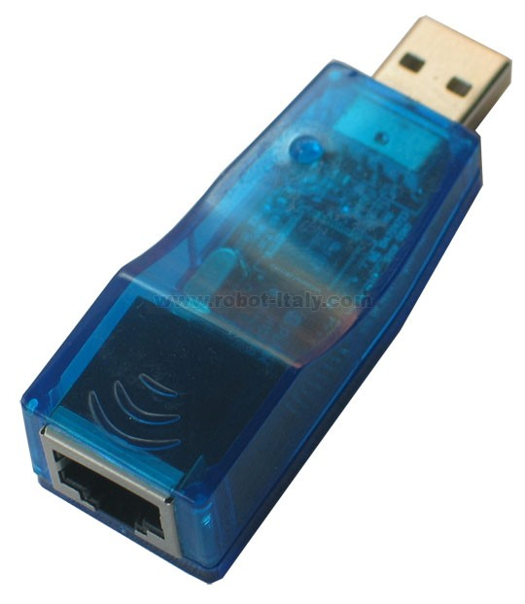
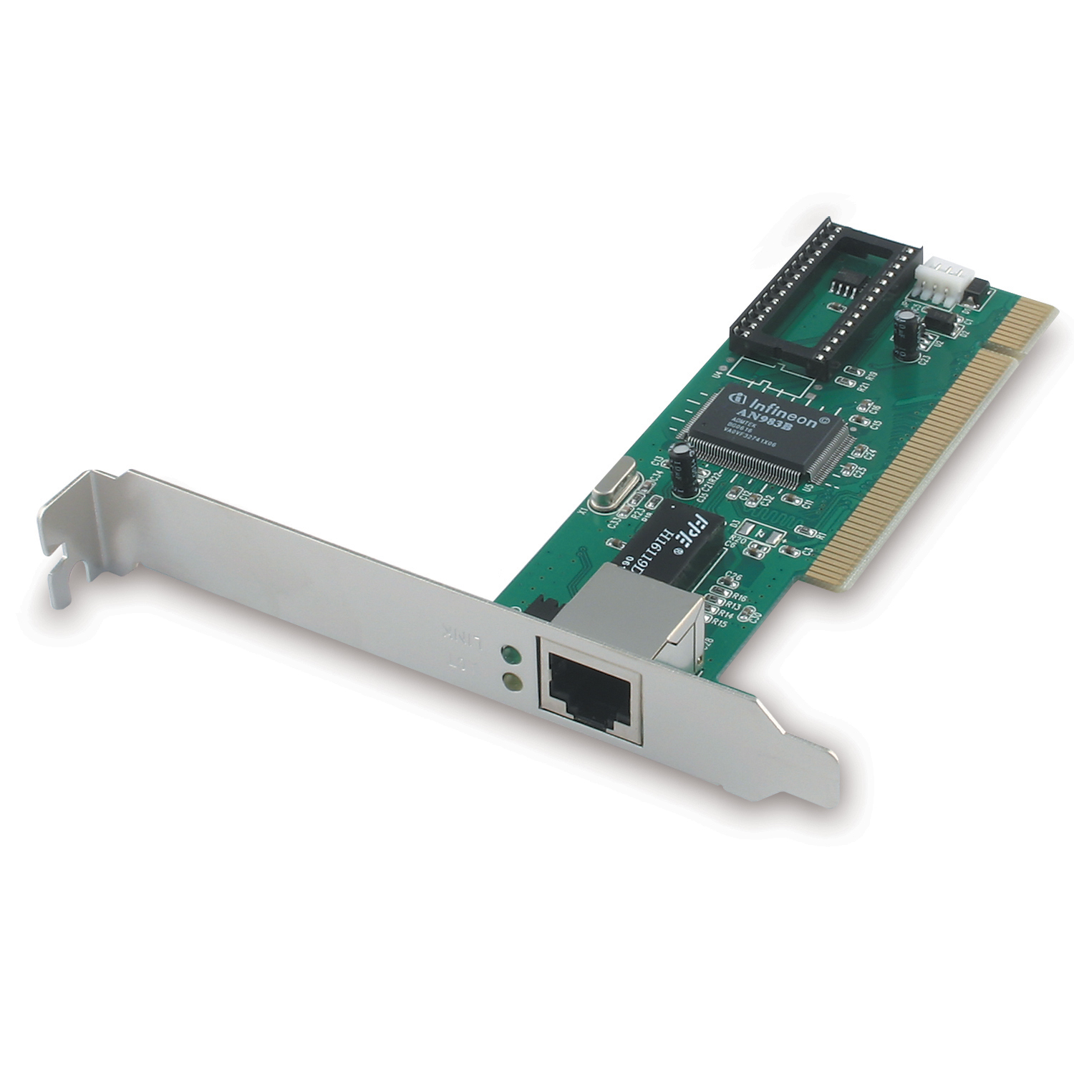
Adaptors Communicating
data
link layer protocol
receiving
node
sending
node
frame
frame
adapter
adapter
link layer implemented in “adaptor” (aka NIC)
Ethernet card, UMTS/LTE, 802.11 card
sending side:
encapsulates datagram in a frame
adds error checking bits, rdt, flow control, etc.
receiving side
looks for errors, does flow control, etc.
extracts data, passes to rcving node
adapter is semi-autonomous
link & physical layers

Slide 13
Link Layer Services – This Lecture
Framing and Addressing
Channel Access (or Medium Access Control)
Next lecture
Error control coding

Slide 14
Link Layer Framing
NPDU = Network Packet Data Unit
How does Router know the “frame” is meant for it?

Slide 15
Addressing in the “Header”
Data Link Layer addresses
Locally significant address used to identify node
Often called Medium Access Control (MAC) address
48 bits in Ethernet, WiFi
Can be burned (hardware) into NIC
Hosts are known to a subnet (e.g., LAN) by their local attachment MAC address
An IP address does not help deliver a packet on a link
NIC = Network Interface Card

Slide 16
Example: Framing in Ethernet
Link Layer framing generally involves
Header and Tail Blocks to encapsulate Network Layer packet
Header and Tail blocks normally include Link Layer address and error control bits
Format depends on specific Layer 2 protocol
General packet format in Ethernet
IP Datagram is here
# of bits
These are the MAC addresses
What is CRC?

Slide 17
Example: Framing in WiFi
These are the MAC addresses
What is CRC?
IP Datagram is here
Number of addresses
Duration field – later
Fragmentation (in Seq. Control)

Slide 18
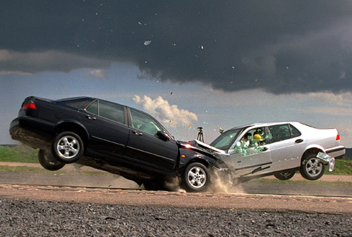
Channel Access: Medium Access Control or MAC
To Internet
MAC protocols needed when using a single shared broadcast link
Two or more simultaneous transmissions by nodes can result in “interference”
Collision if node receives two or more signals at the same time

Slide 19
MAC Protocols: a taxonomy
Channel Partitioning
Divide channel into smaller “pieces” (time slots, frequency)
Allocate piece to node for exclusive use
Examples are TDM and FDM
Random Access
Channel not divided, allow collisions
“Recover” from collisions
“Taking turns”
Nodes take turns, but nodes with more to send can take longer turns
Image Source: http://www.carinsurancecomparison.com/Images/collision-coverage.jpg

Slide 20
Pros and Cons
Channel partitioning MAC protocols:
Share channel efficiently and fairly at high load
Inefficient at low load: delay in channel access, 1/N bandwidth allocated even if only 1 active node!
Random access MAC protocols
Efficient at low load: single node can fully utilize channel
High load: collision overhead
“Taking turns” protocols
Look for best of both worlds!

Slide 21
Channel Partitioning MAC protocols: TDMA
TDMA: time division multiple access
Access to channel in "rounds"
Each station gets fixed length slot (e.g., length = maximum packet transmission time) in each round
Unused slots go idle
Example: 6-station LAN, 1,3,4 have packet, slots 2,5,6 idle
TDM (Time Division Multiplexing): channel divided into N time slots, one per user; inefficient with low duty cycle users and at light load.
FDM (Frequency Division Multiplexing): frequency subdivided.
Two types of frames, be careful

Slide 22
Random Access Protocols
When node has packet to send
Transmit at full channel data rate R.
No a priori coordination among nodes
Two or more transmitting nodes ➜ “collision”
Random access MAC protocol specifies:
How to detect collisions
How to recover from collisions (e.g., via delayed retransmissions)
Examples of random access MAC protocols:
ALOHA, slotted ALOHA
CSMA, CSMA/CD, CSMA/CA

Slide 23
ALOHA
This is a link layer “Frame”
1970: ALOHAnet satellite network in Hawaii
Transmit a link level frame whenever you want!
Wait for an acknowledgement
If there is a collision, wait till a random amount of time and retransmit
Collision => entire packet transmission time wasted for everyone
collision

Slide 24
Slotted ALOHA
Fix the starting/ending times to specific values (slots)
Say t, t+F, t+2F and so on
This reduces the number of collisions
Under heavy traffic conditions, the best success rate is only 36%
Under light traffic loads, it does not matter
Where is this used?
All cellular networks with some modifications

Slide 25
Can we do better?
Carrier sense multiple access (CSMA)
“Sense” the medium to see if it is occupied before transmitting
If channel sensed idle: transmit entire frame
If channel sensed busy, defer transmission

Slide 26
Collisions in CSMA
collisions can still occur: propagation delay means two nodes may not hear each other’s transmission
note: role of distance & propagation delay in determining collision probability
spatial layout of nodes

Slide 27
CSMA/CD (Collision Detection)
CSMA/CD: carrier sensing, deferral as in CSMA
Collisions detected within short time
Colliding transmissions aborted, reducing channel wastage
Collision detection:
Easy in wired LANs: measure signal strengths, compare transmitted, received signals
Difficult in wireless LANs: may be out of range of other user transmitting to same Access Point

Slide 28
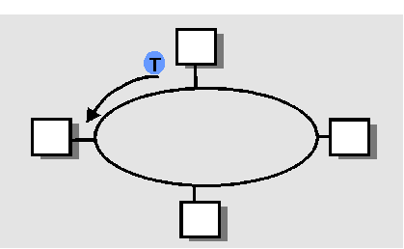
Taking Turns MAC protocols
Token passing (old token ring and bus networks)
Control token passed from one node to next sequentially.
Token message
Concerns:
Token overhead
Latency
Single point of failure (token)

Slide 29
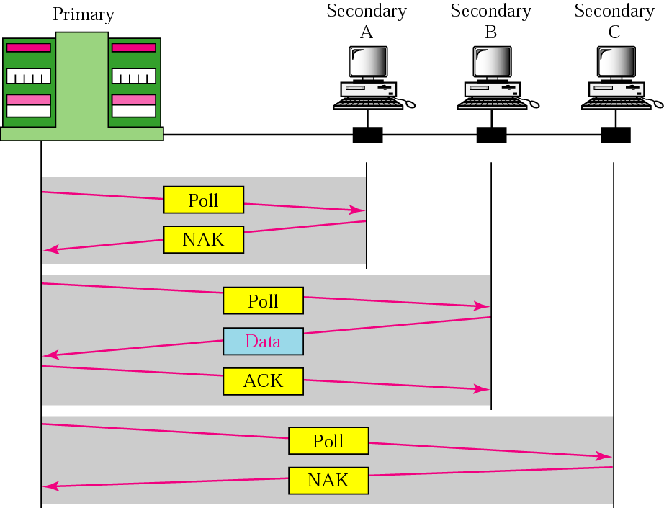
Polling and Scheduling
Bluetooth uses polling
Scheduling is used on cellular links
It is sometimes called “reservation”
(Master)
Figure Source: Forouzan

